Slide 1
CSDS 451: Designing High Performant Systems for AI
Lecture 1
8/26/2025
Sanmukh Kuppannagari
sanmukh.kuppannagari@case.edu
https://sanmukh.research.st/
Case Western Reserve University

Slide 2
Outline
Course Information
Course Overview
Introduction to Heterogeneous Computing
Introduction to Key AI/ML Kernels

Slide 3
Outline
Course Information
Course Overview
Introduction to Heterogeneous Computing
Introduction to Key AI/ML Kernels

Slide 4
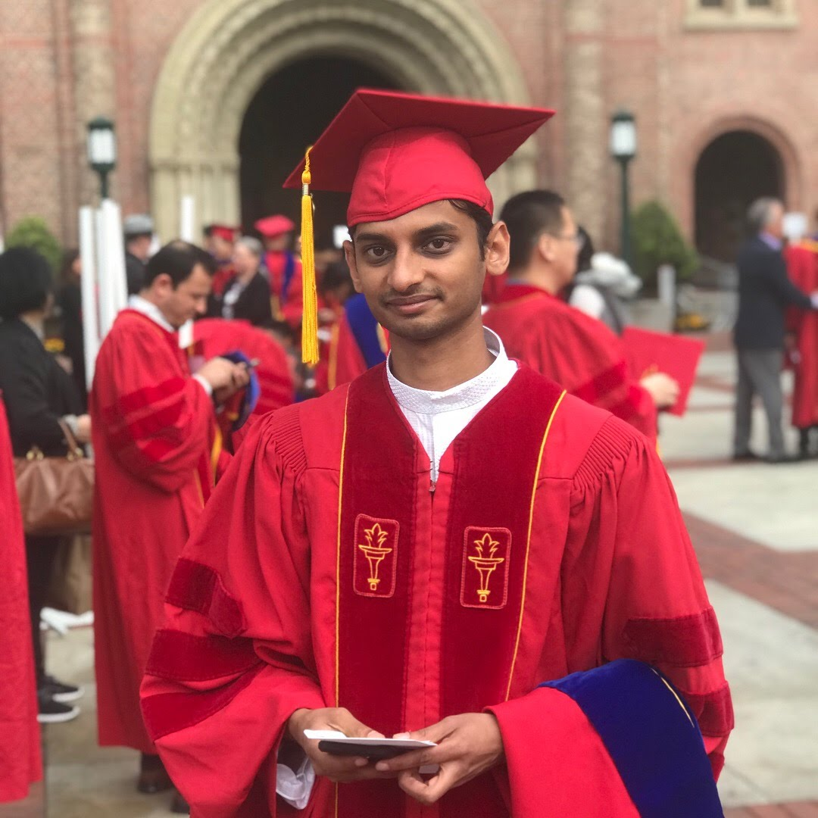
Introduction
Assistant Professor, Case – Fall 2022 - present
Senior Research Associate/Post Doc, USC – Fall 2018 to Summer 2022
PhD, Fall 2018, USC
B.Tech, CSE, 2011, IIT Guwahati
Research Focus: Accelerating AI Algorithms
Team
3 PhDs, 3 Masters, 2 undergraduates
https://sanmukh.research.st/people

Slide 5
Research
Deploy real-time, low-power, low-latency CNN models on Processing-in-Memory (PIM) architectures
Scaling Transformer Models to Extremely Long Sequences by Exploiting Sparsity
Scalable Training of Geometric Graph Neural Networks
Scalable Training of Fourier Domain Models

Slide 6
Basic Information
Lecture: Tuesday, Thursday 4:00 – 5:15 pm, Olin 305
Office Hours
Location: Olin 506
Times: TBD

Slide 7
Course Goals
Objective: Provide a broad overview of the challenges and opportunities that exist in designing high performance AI systems
Key Focus: Algorithmic Innovations
Course Audience
Data Scientists who want to look under the hood and speed up their models
Parallel Algorithms or Hardware Acceleration researchers

Slide 8
Course Pre-requisites
Algorithms
Complexity Analysis
Problem solving
…
Mathematical/Computer Science maturity
Familiarity with Programming (preferably C/C++)
Ability to write programs given an algorithm
Ability to debug your programs or find answers online if you are stuck
In this world of Generative AI, programming language should not be a barrier
Most importantly, ability to quickly learn new concepts
Most critical skills for a computer scientist given how fast our field evolves

Slide 9
Course Objectives
Theory
Parallel Computing Basics
Algorithms to Accelerate Convolutional Neural Networks (CNN), Large Language Models (LLMs), and Distributed Training on a Cluster
Practice
BLAS libraries for High Performant AI/ML kernel implementations
Heterogeneous Programming using AMD HIP
Pytorch Lightning for distributed training on a cluster

Slide 10
Grading Policy (1)
Grading
Written Assignments (30%)
Programming Assignments (20%)
Mid-term exam (15%)
Final exam (15%)
Project (20%)
Watch out for extra credit assignments or bonus points in your assignments

Slide 11
Grading Policy (2)
Written Assignments (30%)
3 assignments to test the theoretical concepts covered in the class
Fairly involved
Programming Assignments (20%)
2 assignments on programming frameworks covered in the class
Due date typically within 2 week from the assigned date

Slide 12
Grading Policy (3)
Mid-term (15%)
9th October
In class
Final (15%)
25th November
In class
Similar to assignments but in a timed manner
Will be open books/slides
No exam during the final exam day

Slide 13
Grading Policy (4)
Project (20%)
Implement one or more AI model
Using one or more acceleration technique
Using one or more heterogeneous programming frameworks
Groups of 2
Source code and project report due during the finals week
I will provide more details during the semester on expectations, topics, team formation and submission guidelines

Slide 14
Grading Policy – Late Assignments
10% reduction in achieved score per day with a total grace of 3 days. 0 points after 3rd day
Only exceptions for medical reasons

Slide 15
Pre-Requisite Knowledge Assignment
Programming Assignment 0 has been uploaded
Objectives:
Warm up your C/C++ skills
Illustrative of the complexity of the programming assignments in the course
Counts as 2% extra credits

Slide 16
Reading Materials
No textbook as the topics discussed are based on cutting edge research
Course slides are intended to explain topics in sufficient detail
List of papers will be provided for students to review

Slide 17
Course Guidelines (1)
Please start assignments early
Please take advantage of the office hours
Asking questions in class is encouraged
Please check the course canvas regularly

Slide 18
Course Guidelines (2)
Policy on using AI tools
Use of AI tools encouraged for background research
Caveat: beware of hallucinations or misinformation
Could be a good tool to understand a topic covered in class
Could be a good tool to debug your programs if you are stuck
Please refrain from directly asking the solutions for written or programming assignments
Please keep me updated on your use of these tools. We as faculty would like to learn how students can best benefit from these tools while maintaining academic integrity

Slide 19
Course Slack Channel
To Be Created
Will put an announcement on canvas

Slide 20
Outline
Course Information
Course Overview
Introduction to Heterogeneous Computing
Introduction to Key AI/ML Kernels

Slide 21
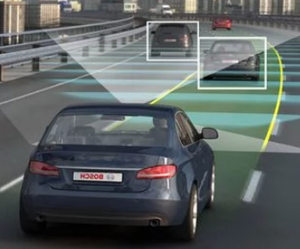



Why This Course? (1)
AI Increasingly Integral to Real-World
Autonomous driving
Surveillance
AI
Social Media
Power Grids
Notes:
Autonomous driving image source: https://www.autoevolution.com/news/germany-to-upgrade-autobahn-for-more-autonomous-driving-support-91679.html#agal_0
Surveillance Image source: https://www.securityinfowatch.com/video-surveillance/news/12082966/245-million-surveillance-cameras-installed-globally-in-2014-ihs-says
Social Media Image Source: https://panorbit.in/blog/why-social-media-is-a-must-for-brands/
Power Grids Image: DOE SETO

Slide 22
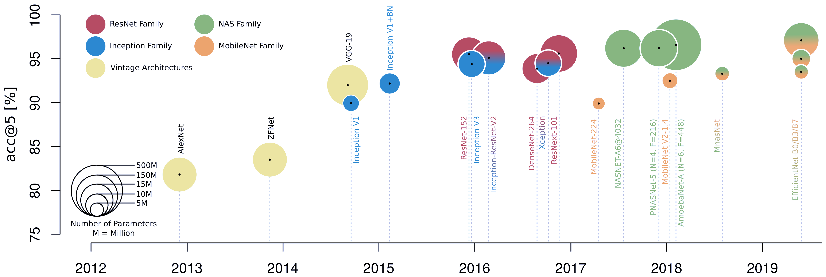
Why This Course? (2)
Models are increasing in size and complexity
Residual
connections
Various Inception
modules
frequency-domain CONV
Point-wise &
Depth-wise
CONV
1*n kernels
“Im2col”
Winograd
“kn2row”

Slide 23
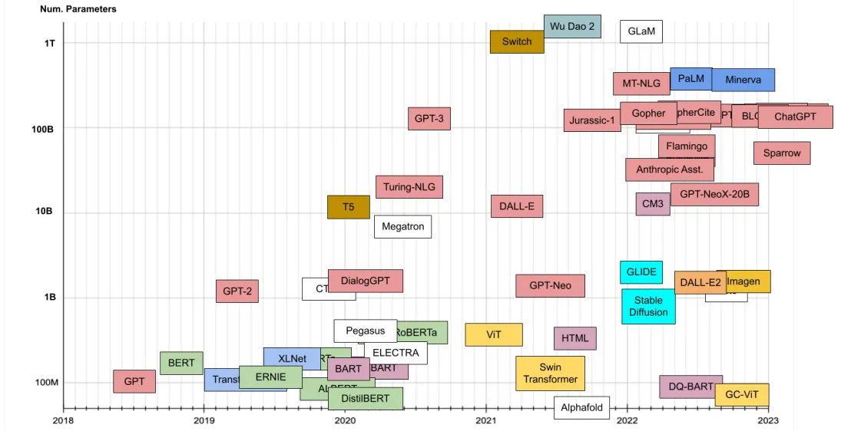
Why This Course? (3)
Notes:
Image Source: https://www.shaped.ai/blog/do-large-language-models-llms-reason

Slide 24
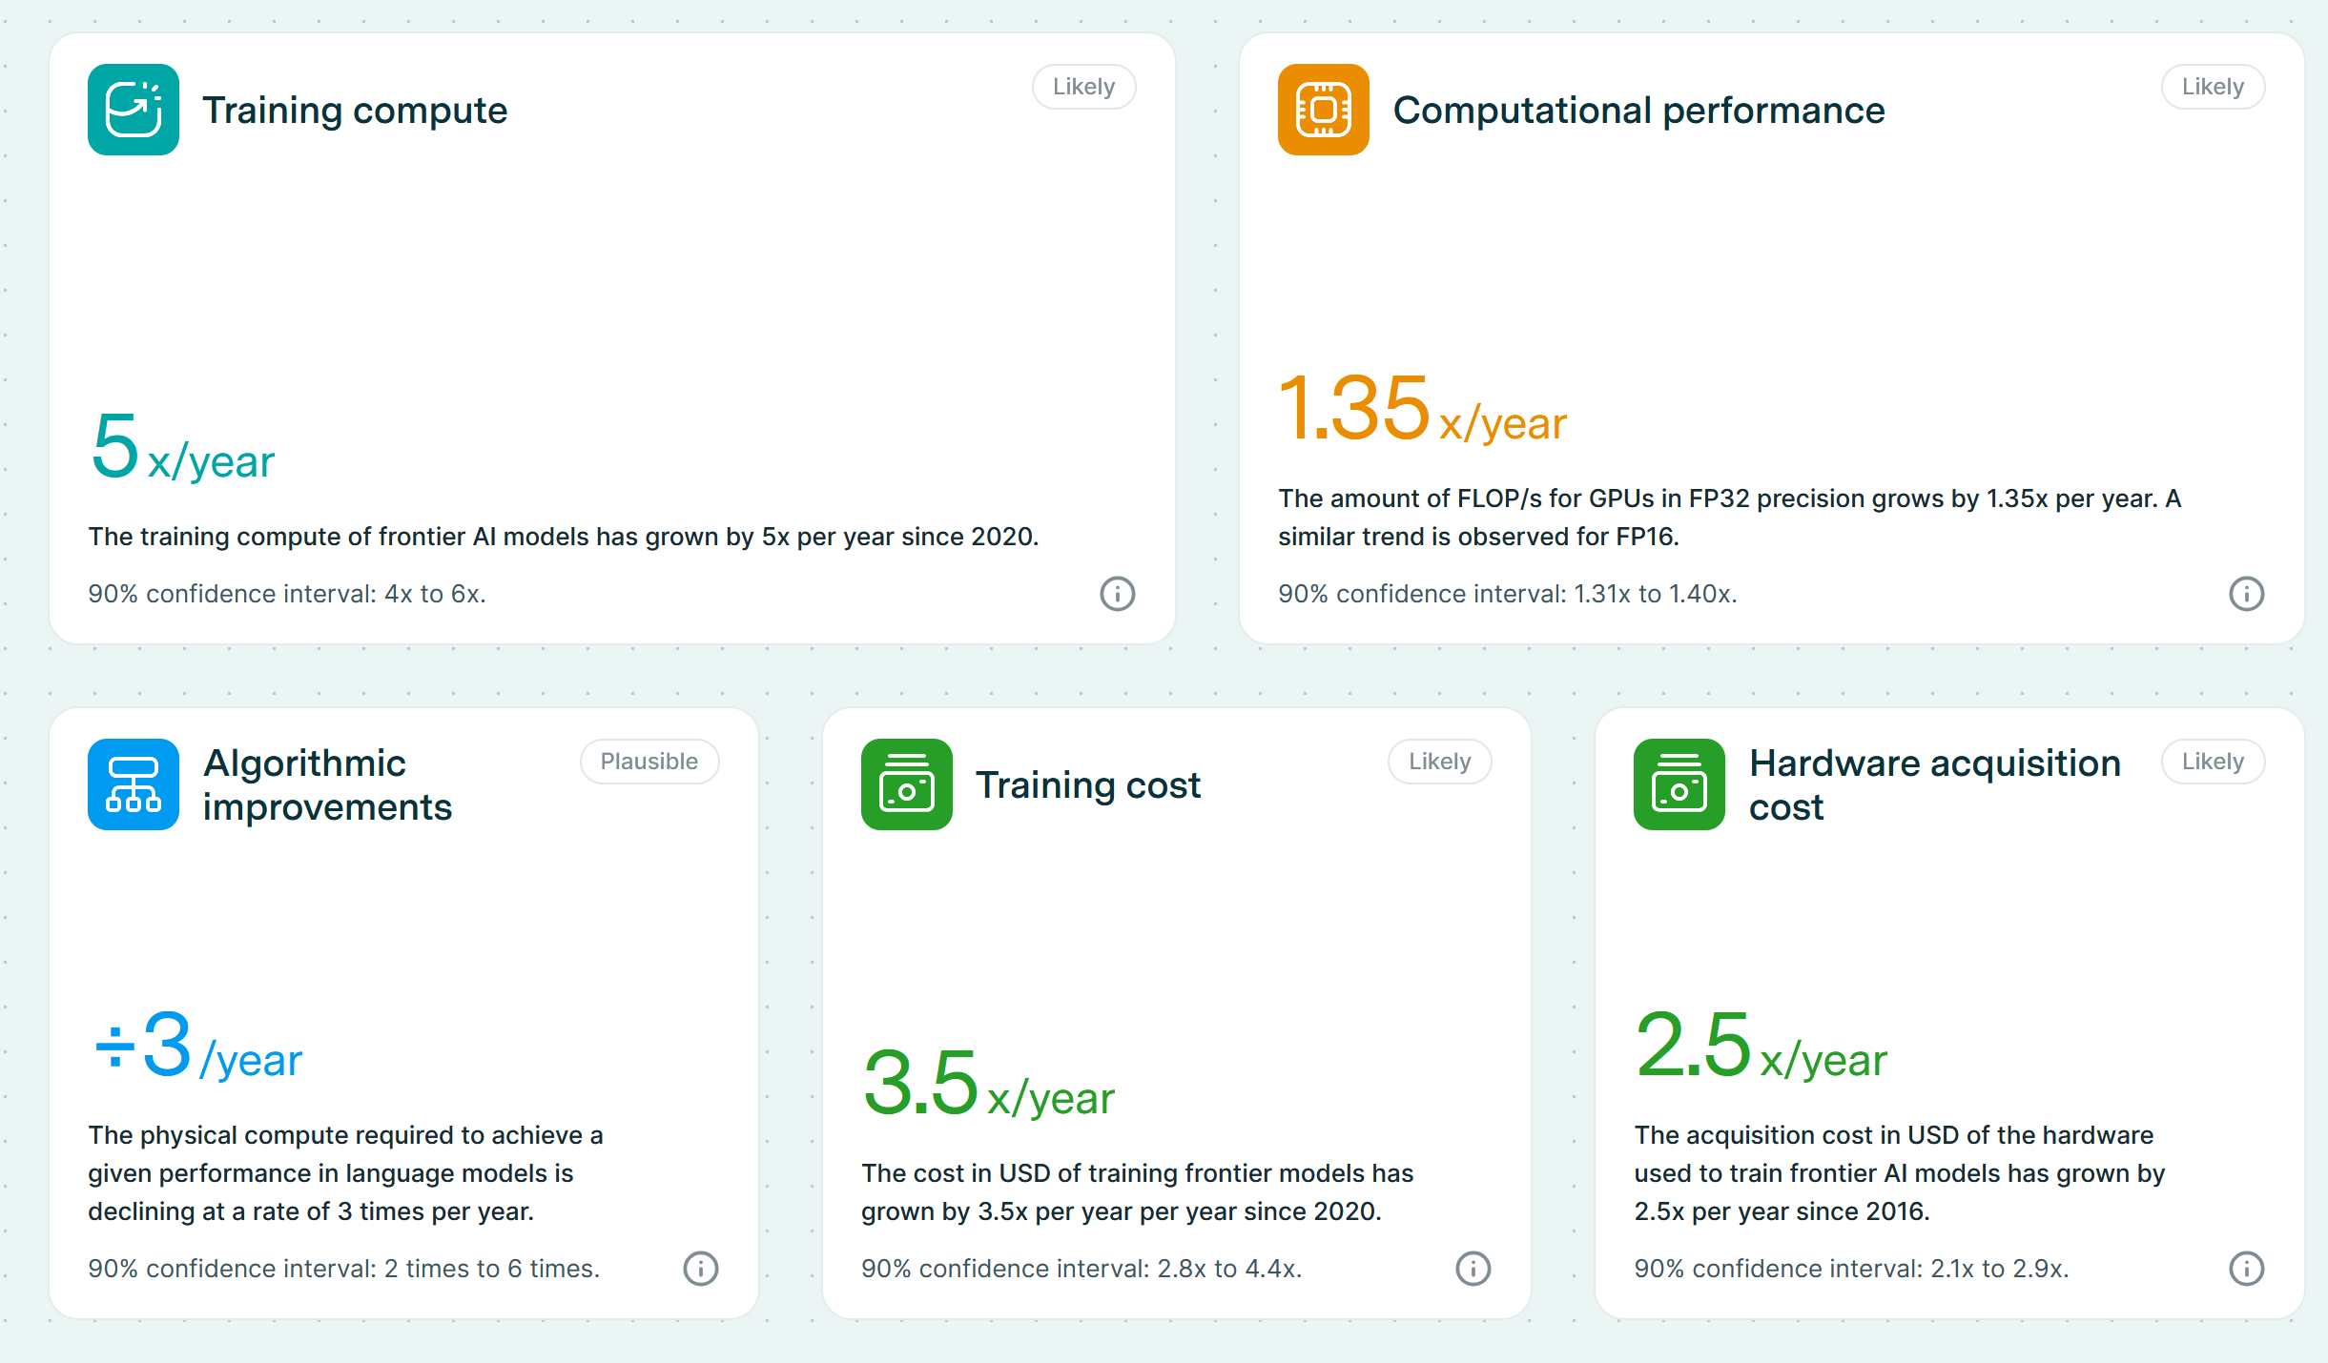
Why This Course? (4)
Gap between training compute requirements and available computation performance keeps on increasing
Source: https://epoch.ai/trends

Slide 25
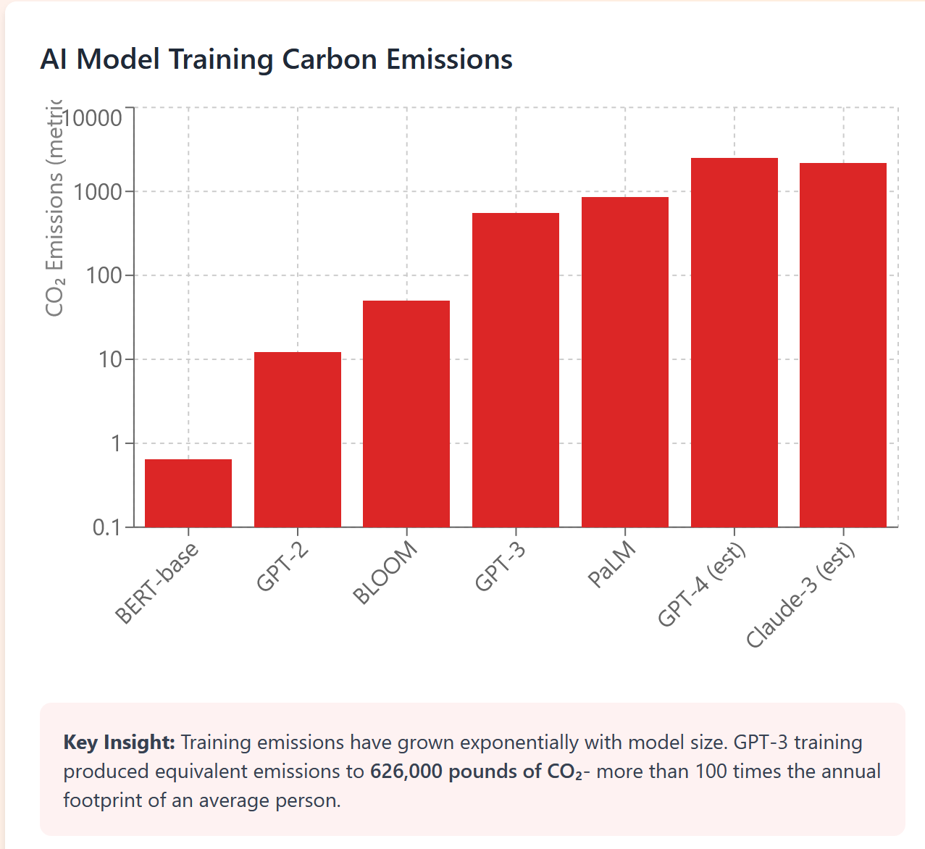
Why This Course? (5)
https://claude.ai/public/artifacts/c4d13724-3130-4d23-89b6-63b08514b299
(Not sure how much CO2 got emitted when I created this interactive graph in Claude)

Slide 26
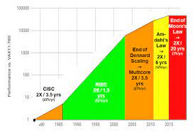
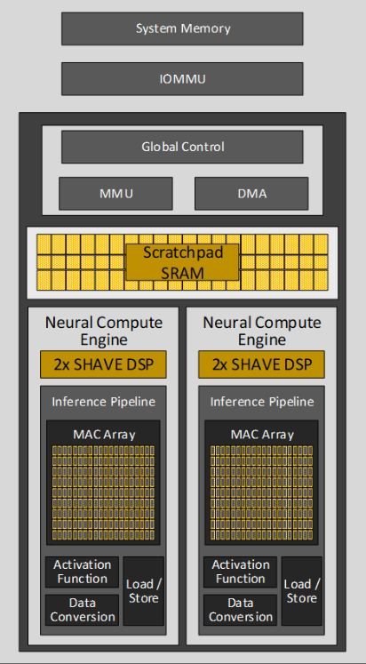
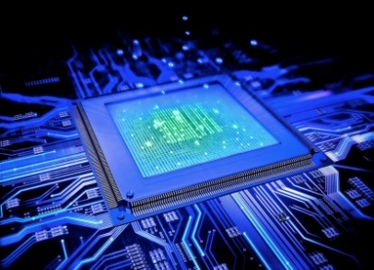

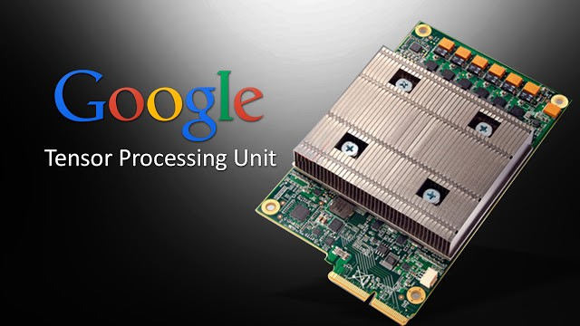
Why This Course? (6)
Rise of Domain Specific Architectures
End of Moore’s Law: Power becomes key constraint
Limitations and inefficiencies in exploiting instruction level parallelism: reaching Amdalh’s law’s limits
Shift in Application focus: individual devices, IoT, data-oriented, AI/ML…
+
CPU
NPU
GPU
TPU
Figure from Presentation: The End of Moore's Law, CPUs (as we know them), and the Rise of Domain Specific Architectures, John Hennessy, September 2019

Slide 27
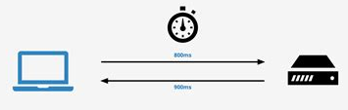
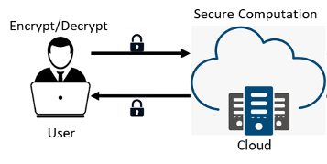
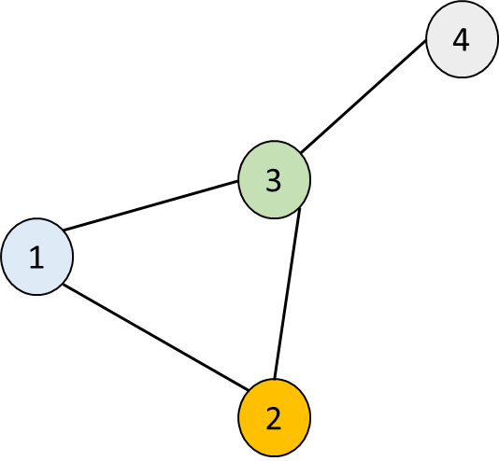
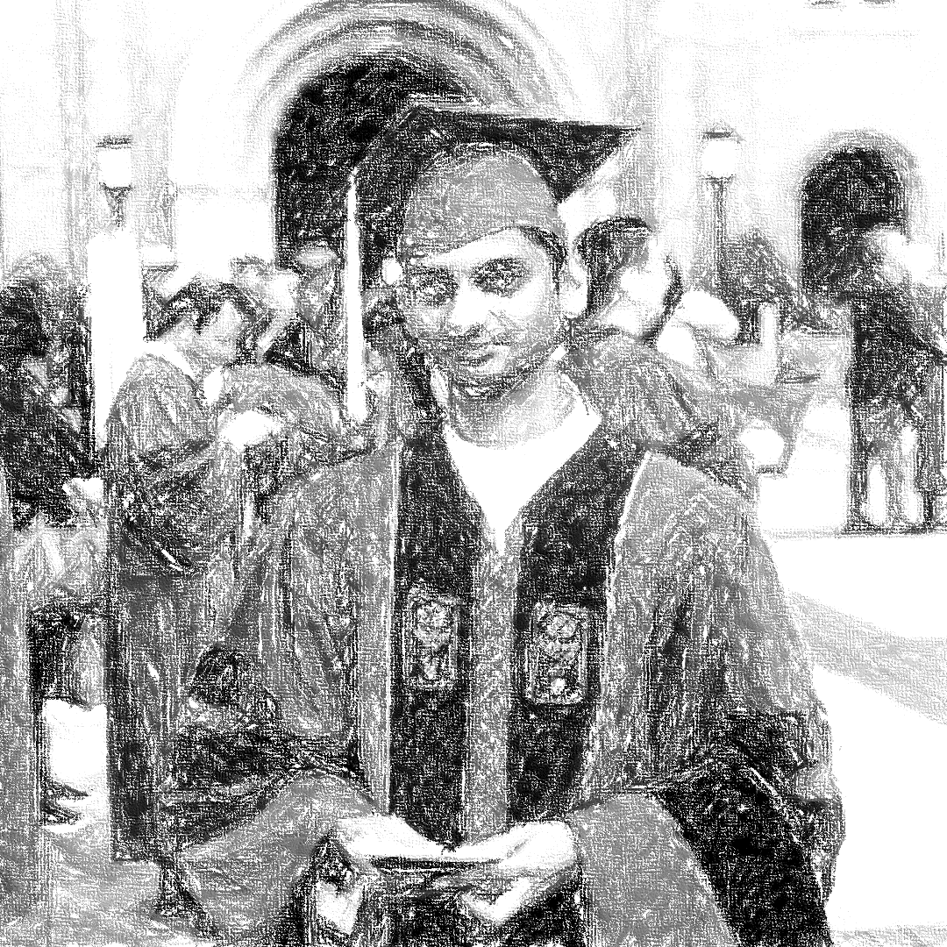

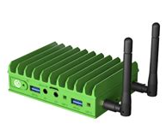

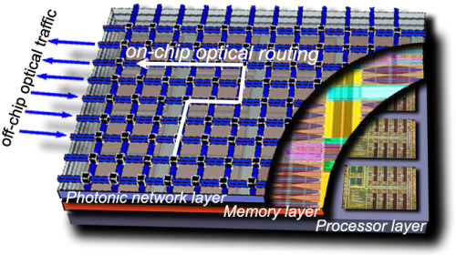
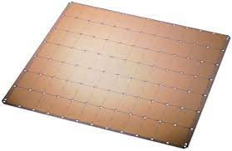
Why This Course? (7)
Performance
Latency, throughput, …
Privacy
Security Level, Scheme, …
Data
image, graph, …
…
…
Systems Person
Power
Datacenter, edge, …
Programming
General Purpose, vector, spatial, …
Technology
Optical, ASICs, Reconfigurable

Slide 28



Why This Course? (8)
Data Scientist

Slide 29
Why This Course? (9)
Building accurate AI/ML models is not sufficient
You should be able to deploy them efficiently in real world for them to be impactful
Time is $$$
Deep learning frameworks are optimized for widely used use case scenarios
What if your problem does not fit into this?

Slide 30
Why This Course? (10)
Hypothetical Scenarios (inspired by real world anecdotes)
You are a data scientist at a security company that performs intrusion detection using images. The client wants the model to be hosted on their premises on a low cost server.
You are a research scientist at a biomedical imaging company. A new dataset you want to explore has 10x the number of pixels and cannot be simply handled using your current GPU server.

Slide 31
Why This Course? (11)
Hypothetical Scenarios (inspired by real world anecdotes)
You are a data scientist at a security company that performs intrusion detection using images. The client wants the model to be hosted on their premises on a low cost server.
You are a research scientist at a biomedical imaging company. A new dataset you want to explore has 10x the number of pixels and cannot be simply handled using your current GPU server.
Will you ask your client or company to upgrade server?

Slide 32
Why This Course? (12)
Hypothetical Scenarios (inspired by real world anecdotes)
You are a data scientist at a security company that performs intrusion detection using images. The client wants the model to be hosted on their premises on a low cost server.
You are a research scientist at a biomedical imaging company. A new dataset you want to explore has 10x the number of pixels and cannot be simply handled using your current GPU server.
Will you ask your client or company to find a systems/parallel computing engineer?

Slide 33
Topics
Parallel Computing Basics
Learn how to model three popular computing platforms – processor-memory architecture (GPUs), Systolic arrays (TPU), cluster
Heterogeneous Computing Framework
Learn how to program CPU+accelerator platforms
AI/ML Acceleration – Apply the above two concepts to accelerate AI models
Convolutional Neural Network Acceleration
Transformer Model Acceleration
Distributed Training of Neural Networks

Slide 34
Outline
Course Information
Course Overview
Introduction to Heterogeneous Computing
Introduction to Key AI/ML Kernels

Slide 35
Acknowledgements
Slides on Heterogeneous Computing are borrowed from the TOUCH program
Faculty Training Workshop for Teaching Heterogeneous Computing
Heterogeneous Computing Resources: https://touch.cs.txstate.edu/training_ws22_resources.php

Slide 36

What’s a Computer?
Von Neumann Architecture
Computer

Slide 37
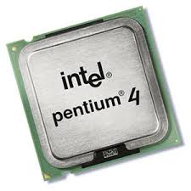
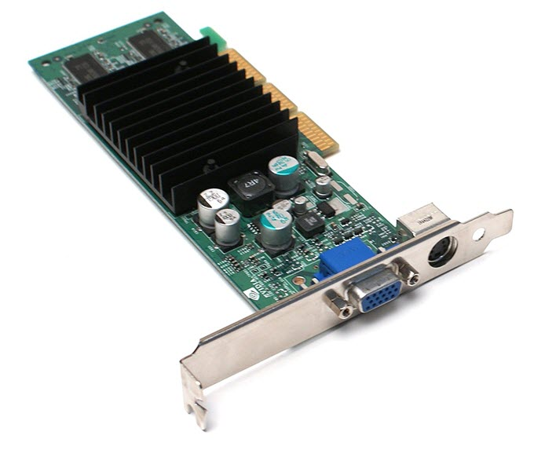

Evolution of Parallelism in Processors
+
Single Core Computing
Multi-Cores/ Multi-Processor Computing
Heterogeneous Computing
Pipelining
Out of order execution
…
Multi-threading
Parallel For
Parallel Tasks
Tasks to core mapping
…
Parallel For
Parallel Tasks
Capability based Task to Device Mapping
…
Hidden from Programmer
Explicit Specifications from Programmer

Slide 38
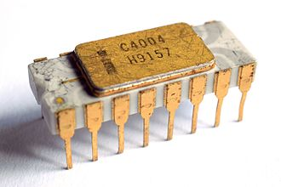
Single Core Computing
Intel 4004
Intel Pentium

Slide 39
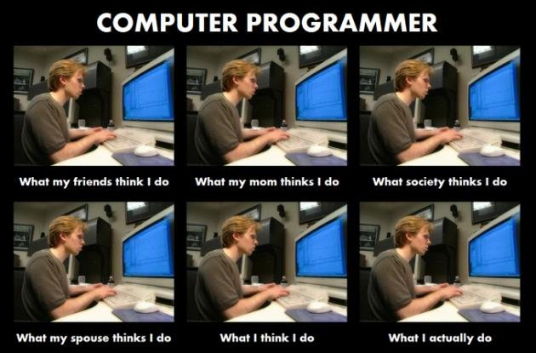
Single Core Computing
.text
.globl _main
_main:
LFB2:
pushq %rbp
LCFI0:
movq %rsp, %rbp
LCFI1:
movl $17, -4(%rbp)
movl $13, -8(%rbp)
movl -8(%rbp), %eax
addl -4(%rbp), %eax
movl %eax, -12(%rbp)
movl -12(%rbp), %eax
leave
ret
Tuning Level
compile
execute
…11001010100…
code
int main() {
int x, y, result;
x = 17;
y = 13;
result = x + y;
return result;
}
Notes:
39

Slide 40
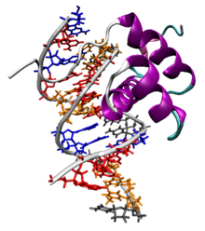
Program Execution
11001010100
x = 17;
time
Tuning Level
11001110101
y = 13;
DONE!
int main() {
int x, y, result;
x = 17;
y = 13;
result = x + y;
return result;
}
code
00001010100
result = x + y;
compile
10101010100
return result;
Instruction execution follows program order
Processor executes one instruction at a time*
Notes:
40

Slide 41
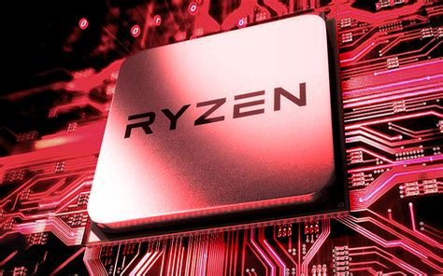
Multi-Core/Multi-Processor Computing
Intel i7
AMD Ryzen

Slide 42
Parallel Program Execution
x = 17;
time
Tuning Level
y = 13;
DONE!
int main() {
int x, y, result;
x = 17;
y = 13;
result = x + y;
return result;
}
code
result = x + y;
compile
return result;
The two assignment statements
x = 17; and y = 13; will execute in parallel
Notes:
42

Slide 43
Parallel Program Execution
int main() {
int x, y, result;
x = 17;
y = 13;
result = x + y;
return result;
}
y = 13;
x = 17;
time
y = 13;
x = 17;
result = x + y;
result = x + y;
Cannot arbitrarily assign instructions to processors
return result;
return result;
Notes:
43

Slide 44
Dependencies in Parallel Code
If statement s_{i} needs the value produced by statement s_{j} then, s_{i} is said to be dependent on s_{j}
All dependencies in the program must be preserved
This means that if s_{i} is dependent on s_{j} then we need to ensure that s_{j} completes execution before s_{i}
s_{j}
y = 17;
...
...
x = y + foo();
s_{i}
responsibility lies with programmer (and software)

Slide 45
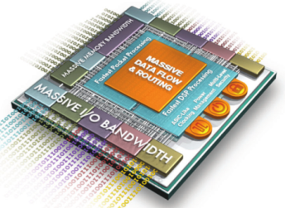
Heterogeneous Computing Heterogeneity
CPU + XPU
XPU = GPU, FPGA, NPU, custom accelerator
CPU
Runs OS; performs general bookkeeping
Offloads Task to XPU
XPU
Processors specialized to perform a particular type of task
Trades off generalizability with performance
CPU
+
FPGA
GPU
TPU
XPU
For more info on XPU: https://www.intel.com/content/www/us/en/architecture-and-technology/xpu.html

Slide 46
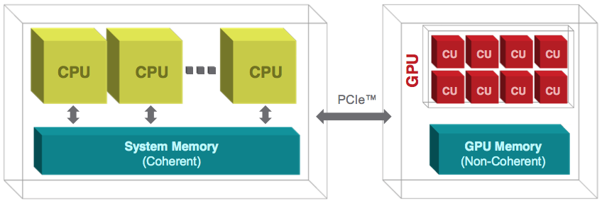
CPU + GPU Heterogeneity

Slide 47
CPU + GPU Heterogeneity
CPU
Runs the main program
GPU
Runs the “kernel” program
Specializes in Data Parallel Programming
Excels at
Dense, parallel, structured, computations
Image based; Dense Matrix based
Limited for
Sparse irregular workloads
Graph based; …
…
GPU Cores
Data

Slide 48
CPU+FPGA Heterogeneity
CPU
Runs the main program
FPGA
Specializes in “User Programmed” Task
Excels at
Dense parallel structured computations
Sparse Irregular computations
Caveats
FPGA computation speeds 10x slower than GPUs

Slide 49
Crash Course in FPGAs (1)
Field Programmable Gate Array
Programmable Logic Blocks +
On-Chip Memory +
Programmable Interconnects
Logic + Interconnect can be programmed to represent ANY program/circuit/algorithm

Slide 50
Crash Course in FPGAs (2)
Why FPGAs?
“Programmable” Hardware
Processors/Microcontroller
Inherently constrained by Instruction Set
Limited parallelism
FPGAs
No software, no instruction set constraints, a digital circuit that implements the exact functionality
High fine grained parallelism
We will not discuss in the class but if you are interested to do projects on FPGA as opposed to GPUs, contact me directly

Slide 51
Heterogeneous Computing Heterogeneity
x = 17;
time
int dostuff(int z) {
int x, y, result;
x = 17;
y = Complicated_F(z);
result = x + y;
return result;
}
y = Complicated_F(z);
Tuning Level
DONE!
result = x + y;
return result;
Offload Complicated Function to XPU
XPU
Notes:
51

Slide 52
Example Frameworks (1)
Pytorch/Tensorflow: CPU+GPU
python based ML framework
Deep Graph Library: CPU+GPU
Python based graph learning framework
OpenMP: CPU + XPU (currently XPU = GPU)
Pragma based programming for heterogeneous computing

Slide 53
Example Frameworks (2)
OneAPI: CPU+XPU (XPU = GPU or FPGA)
C++ based device agnostic programming
CUDA/HIP: CPU+GPU
C/C++ based programming for GPU
High Level Synthesis (HLS): CPU + FPGA
Pragma based programming for FPGA
Typically, used in conjunction with OpenCL

Slide 54

Pytorch
Open Source ML Framework
Explore
Basics of ML Model development
Distributed ML (later in the course)
Pytorch: https://pytorch.org/
Notes:
Image source: Pytorch

Slide 55
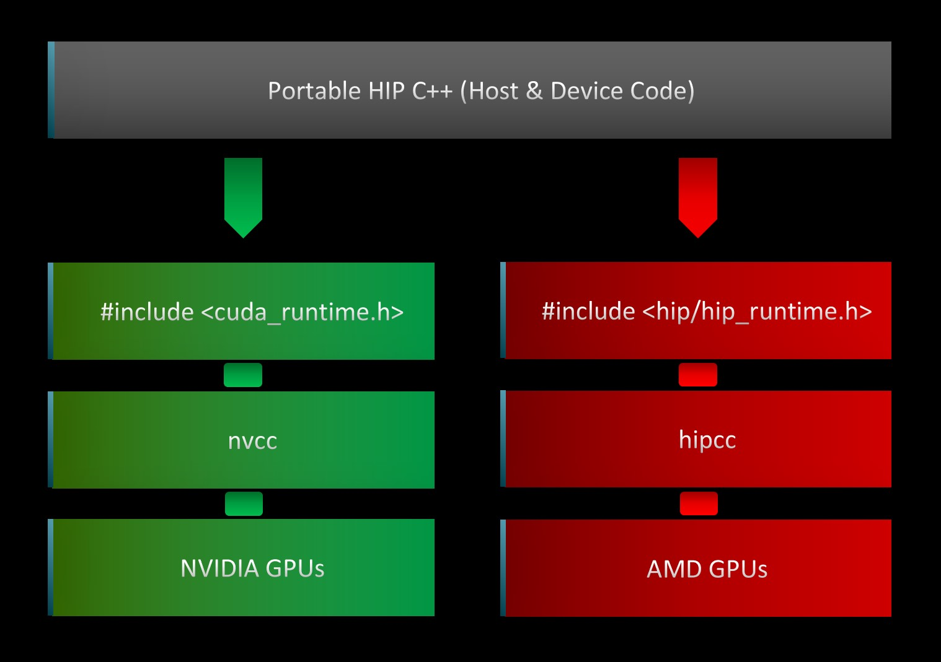
Heterogeneous-compute Interface for Portability (HIP)
C++ based runtime API and kernel language
Enables developers to design platform-independent GPU programs that can run on both AMD and NVIDIA GPUs
Syntax very similar to CUDA

Slide 56
Our Focus in this Course
Target Platform – CPU+GPU Heterogeneous Platforms
Programming Frameworks
C++ - CPU-only
HIP – CPU+GPU
Pytorch – CPU+GPU

Slide 57
Outline
Course Information
Course Overview
Introduction to Heterogeneous Computing
Introduction to Key AI/ML Kernels

Slide 58
Key Computational Kernels in Machine Learning
Majority of Computations in Machine Learning occur using a small set of kernels (operations that are a bit more complex than addition/multiplication)
Vector – Vector Operations
Matrix – Vector, Matrix – Matrix Operations
Sparse Matrix Operations
Hashing
Message Passing on Graphs

Slide 59
Ungraded HW Assignment
Use your favorite generative AI tool to learn about each of the kernels
We will introduce them in this class as and when needed

Slide 60
Next Class
8/28 Lecture 2 – Processor-Memory Architecture – Modeling, Analysis, Challenges, Opportunities for Optimization

Slide 61
Thank You
Questions?
Email: sanmukh.kuppannagari@case.edu

